Slide 1
Muscle Hub A/B Testing Report
Yizhou Hu
October 1st, 2020

Slide 2
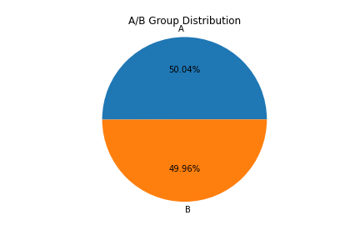
A/B Group Distribution
A/B groups are evenly separated, of total number 5004 customers

Slide 3
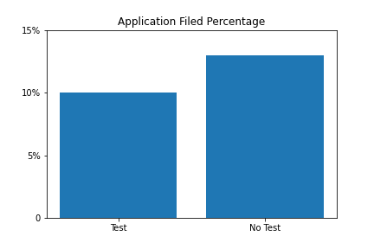
Percentage of Filing Application
Customers without doing fitness test are more inclined to file application
13% vs 10%
Chi2 contingency score: 0.00096

Slide 4
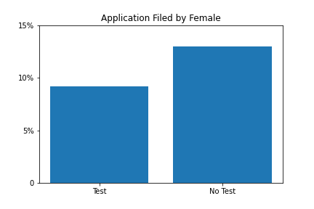
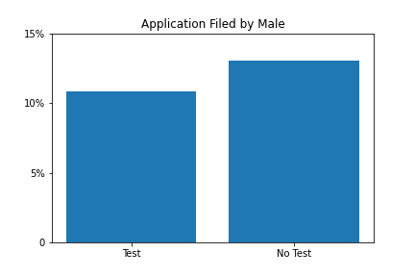
Look into Gender (Percentage of Filing Application)
Female customers seem more “scared” of the fitness test than male customers
Female Chi2 contingency score: 0.00256
Male Chi2 contingency score: 0.105

Slide 5
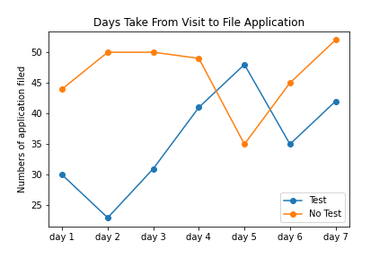
Look into “Hesitation” (Percentage of Filing Application)
The fitness test turns some customers away

Slide 6
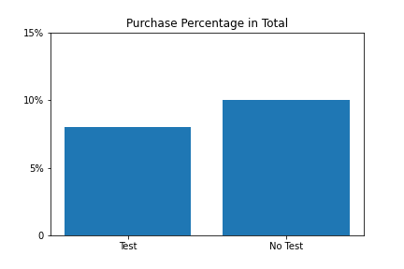
Purchase Rate
Not a surprise, higher purchase rate
in no fitness test group
10% vs 8%
Chi2 contingency score: 0.014

Slide 7
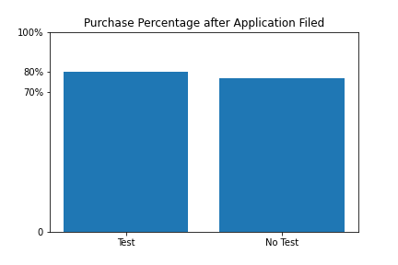
Purchase Rate of Whom Files Application
We may guess customers who did the fitness
test and filed application have more
commitment with the club
80% vs 77%
Chi2 contingency score: 0.43

Slide 8
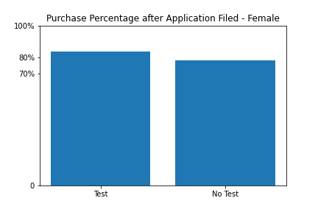
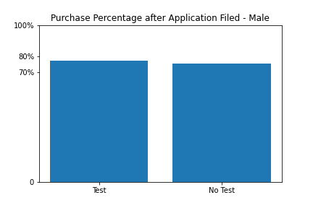
Look into Gender (Purchase Rate of Whom Files Application)
For the group who take the fitness test, female customers seem
more committed than male customers
Chi2 contingency score: 0.267

Slide 9
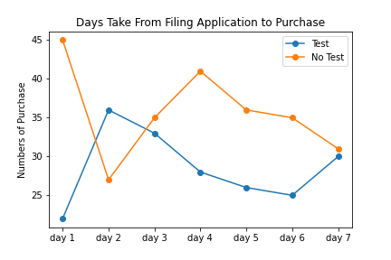
Fitness Test is “Scary”
Customers don’t want to enroll even though
they have filed the application on day 1

Slide 10
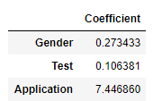

Machine Learning Model - Logistic Regression
Features: gender, w or w/o fitness test, application filed or not
Label: made purchase or not
Model score: 0.969
Model coefficient
Prediction probability

Slide 11
Recommendations
Offer the fitness test to the selective customers by surveys
Make different fitness tests to target different groups of customer
Offer promotion plans to customers who filed applications to motivate them to enroll asap
Offer fitness plan right after customers take the fitness test

Slide 12
Conclusion
Current fitness test is counter productive
More customer information is needed for a better model prediction
Filing application is decisive
More customer features are needed (age, purpose, etc)

